Slide 1
Documentation
Or… “if it wasn’t written down, it didn’t really happen”
(not quite!)
Notes:
Usually… you could say that if you haven’t recorded something, that there is no proof it happened. We have all heard about times when meds records weren’t filled out and an individual was dosed twice. Some people have taken this saying to mean that if they didn’t write it down, they can’t be blamed for something that has gone wrong. But it is better to have recorded the information according to policy and procedure than rely on circumstantial evidence or someone’s memory a long time later if an incident goes to court.

Slide 2
What documentation do we work with in Cara?
Customer files
Communication book
Medication charts & records
Medical documentation (eg: bowel charts)
ABC Charts
Incident reports
Case notes
Think about your work and add to this list
Notes:
Eg: need for restrictive practice, health support assessment, mandatory notification, risk assessment, information sharing decisions.
If you don’t keep notes for example, how do you prove the needs of your customer have changed and get their needs met? How do you prove that the individual, their guardian and other relevant others have had input into the customer’s care and support and that plans are relevant to goals they want to meet?
Need to understand that the Communication Book is not enough for documenting customer care and decisions made. BUT… the Communication Book can still be used in court proceedings, so make sure you are mindful of what you write. What might you need to be mindful about?

Slide 3
Why document?
Customer
Legal System
Documentation
Organisation (Cara)
Worker
Notes:
How is documentation important in the legal system? What might the consequences be to Cara if documentation is not done correctly?
Why is documentation important to the customer? To you as a worker???
Need to understand that workers can now be held PERSONALLY liable in civil court proceedings or proceedings in industrial courts.

Slide 4
Why document?
Ensures continuity between staff and that customers receive the same standard of care and care practices no matter who is on duty
Assists with the preparation of reports
Provides justification for action
Assists in supervision
Assists in sound decision making and formulation of plans

Slide 5
Why document?
“an inadequate record is not only evidence of negligence, it is an example of it.”
Improves practice – the quality of the support we provide
Makes us accountable.
Shows
when ethical guidelines have been followed;
what customers have said has been followed;
That we have explained our work honestly – and received informed consent to proceed

Slide 6
Good documentation
Needs to be completed according to Cara policy and procedures
Uses templates provided by Cara
Says nothing you wouldn’t want the customer to read
Is factual
Needs to be completed as soon as possible, especially if there has been a change, an event or an incident
Notes:
The emphasis is on quality, not quantity.

Slide 7
Good documentation should…
Be objective: not include opinion
Be concise: as short as possible to convey the information needed
Use appropriate language: Person first, no slang, correct terminology
Include only necessary information
Notes:
Should never include things like, “she looked like…”, “I thought…” etc
Sometimes the more you write, the more opportunities there will be to say to something that could cause trouble for you, Cara, or even the customer.
Correct terminology: eg: “L was peeing a lot today.” or “L was urinating more than usual.”???

Slide 8
When completing documentation for Cara
Only use black ink
Correction fluid or tape (whiteout) must not be used
Where changes must be made, a line must be drawn through any corrections, the correction initialed and the information rewritten:
mistake
A line must be drawn where documenting does not use all the space available
All notes must be dated (and time recorded if it regards an incident)
All notes must be signed and include the compiler’s name and job role (eg: J Thomas, CSW)

Slide 9
The Owl Checklist (Who Who)
Who – WHO is it about?
Where – WHERE did it happen?
When – WHEN did it happen?
What – WHAT happened?
Why – WHY did it happen?
How – include this only if there if you personal saw an event or incident – otherwise write who told you
PLUS – what you did about it if appropriate
facts
Observations
Assessments
Conclusions?

Slide 10
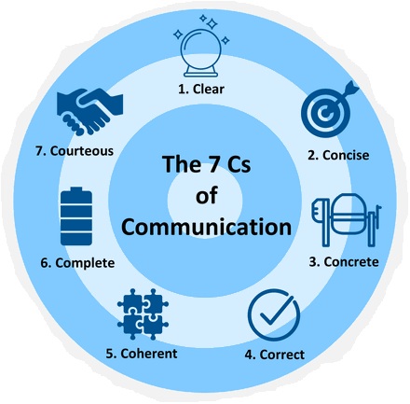
7 X C
Clear
Concise
Concrete
Correct
Coherent
Complete
Courteous

Slide 11
Be:
Clear | …about your purpose: Why are you writing? What result do you want? …about your message. What precisely do you want to say?
Concise | Get rid of unnecessary words and information: Find the shortest most direct way to state your message Use Plain English: Be straightforward and direct.
Complete | Include all necessary information: give enough background to help the reader make sense Don’t assume the reader knows: Avoid jargon, initials (unless instructed) or use specialist language and terminology
Correct | Get grammar and punctuation right: grammar and punctuation make writing make sense Make sure your information is accurate: Just one thing wrong can undermine the credibility of you and Cara
Concrete | Give specific information: Detail the 5 W’s Avoid abstract or vague language: give examples
Coherent | Organise your ideas logically: Ensure conclusions are supported by evidence Use formats and structure: Use clear sequence and easy-to-follow layout
Courteous | Put yourself in the reader’s shoes: Who are they? What matters to them? Use appropriate tone: How do you want them to think of and respond to you?

Slide 12
Final notes:
Spelling and grammar are important
Correct language is very important
Use the ‘active voice’

