Slide 1
Legal vs Ethical in disability support

Slide 2
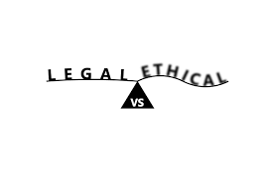
What’s the difference?
Simply…
Legal standards are based on written law.
Ethical standards are based on human rights and wrongs.
Something can be legal, but not ethical.
If only it was really that simple!
Notes:
All laws must be enacted by parliament (State or Commonwealth). In the case of local government they are called by-laws and must have their origin in State of Commonwealth law.
Most law in Australia has its basis in the Judeo-Christian tradition as expressed in the 10 Commandments and on the Magna Carta, which was first written in 1215.
An example of some laws that are/were not ethical include Nazi Germany’s legal persecution of Jews, Homosexuals, Gypsies and people with disabilities during WWII

Slide 3
Most of our laws come from an ethical position – what is right and what is wrong.
These ethical positions started with a human’s or cultural group’s morals
Just to confuse things…
There are some instances where legal acts can be unethical, and there are also times when an ethical act is considered illegal.
Notes:
One example of how a moral position can affect law is community support for the death penalty for example.
More examples of laws that are unethical? And ethical acts are illegal?
Think about the issue of euthanasia

Slide 4
A legal act
applies to all people in a society that has a particular set of laws.
meets the terms of rules and regulations of a particular, but massive entity like a society or a country.
An ethical framework
is usually voluntary and it is a personal act by an individual to comply with it.
Usually complies with the principles and justifications of an individual or a specific organisation.
Doesn’t result in legal punishment if you don’t comply (though it may get you fired from a job!)
Notes:
What are some places that might have ethical frameworks?

Slide 5
Some laws that are based in ethics
Equal Opportunity/anti-discrimination
Child protection
Interpersonal violence
Conflict of interest
Australian Privacy Principles
Any others?

Slide 6
Where do Cara policies come from?
Universal Declaration of Human Rights (1948)
▼
UN Conventions: UN Convention on the Rights of People with a Disability
UN Convention on the Rights of the Child
▼
Australian Commonwealth and State laws: Disability Discrimination Act (1992)
SA Disability Services Act (1993)
SA Equal Opportunity Act (1984)
NDIS Act (2013)
▼
National Standards for Disability
Services (The Standards)
▼
Cara Policies
Other legislation with impact on Cara policy and procedures:
WHS Act (2012)
GST Act (2000)
Other financial and business management legislation
Notes:
See example on the next page.

Slide 7
Staff Professional Conduct SP 1.2
Domain: Staff Policies
Section: Professional conduct / Standards
“I have the right to services and supports that are effectively managed, regularly reviewed, accountable and contemporary”
[National Standards for Disability Services, Standard Six, rights for people]
Notes:
See how every Cara policy has the National Standard for Disability Services standard that applies to that policy included in it?

Slide 8
Compliance
MUST comply with legal requirements
MUST comply with policies because policies are how an organisation implements LAW.
MUST comply with regulations and standards.
Policies can also come from requirements in funding agreements/contracts or licensing bodies
Procedures, Guidelines and Codes
do not HAVE to be complied with legally,
but non-compliance has consequences.
Notes:
One example of a policy that is not based in a legal agreement is the requirement from the Department of Child Protection that CSWs who support children under the Guardianship of the Minister must have, or be studying for, a Cert 4 in Disability.
Regulations and Standards are usually legislated by government – or ‘gazetted’, which means that they have been published in the Government Gazette. The ‘Gazette’ is published each Thursday and contains all the decisions that government departments have to abide by. And if government departments have to comply, then so do the organisations that receive funding from them.

Slide 9
Consequences of non-compliance
Consequences of not complying with legal requirements:
Fines
Cancellation of licences/contracts
Bankruptcy from legal defence
Operational restrictions
Loss of service for clients
Consequences of not complying with ethical requirements:
Mostly personal, but also
Loss of reputation
Loss of business
Loss of employment

Slide 10
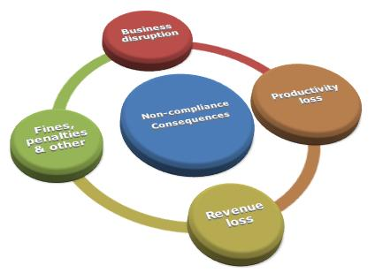

Slide 11
Conflict between law & ethics
These are called Competing Principles.
Common in community services.
For example: Confidentiality vs Reporting an endangering act:
Should a disability worker breach confidentiality to report a customer who has fallen in with a rough crowd and is at risk of committing an illegal act?
Notes:
Also ethical dilemmas… There are no absolutely correct answers to ethical dilemmas.
Eg, the train example: You are standing at a railway junction and you can see a train approaching. If it continues on its path, it will hit and kill a group of children who are playing on the tracks. You can switch the train onto a disused track, where there is a single child playing. What should you do? 95% of people say they would shift the train’s path to kill the one child and save the larger group. However, should the sole child be punished for doing the right thing and playing in the safe place? Wouldn’t at least one of the larger group of children see the train and get out of its way? Also, why is the old train line disused? If it hasn’t been maintained and the train changes path suddenly, the train is likely to derail, injuring and/or killing passengers. The lesson is to get the most information possible and make the least emotional decision possible. The 95% who decide to alter the train’s path make the decision based on emotional equation of the one versus the many and before they have enough information.

Slide 12
Resolving Competing Principles through Ethical Decision Making

Slide 13
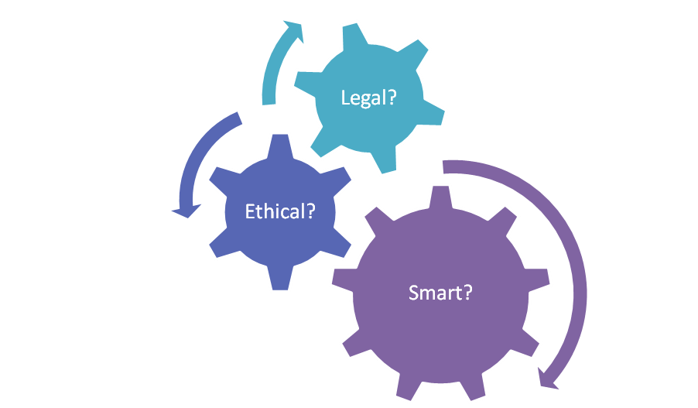
Legal or Ethical? (Let’s play along…)
Children in the Workplace
Code of Conduct
Code of practice
Complaints management
Continuing professional education
Discrimination
Dignity of risk
Human rights
Mandatory reporting
Practitioner/client boundaries
Privacy, confidentiality & disclosure
Policy frameworks
Records management
Employment conditions
Workplace safety
Work role boundaries

Slide 14
Remember…
Just like what’s legal isn’t always ethical and sometimes what’s ethical isn’t legal…
what’s right isn’t always popular and what’s popular isn’t always right
Notes:
What’s an example of something in your work that might be ethical, but not legal. Or a law you think is not ethical.

